Slide 1

Data Analysis Web Application Dashboard
Group 03
Client: Longworth Dental Boutique
Punyaja Mishra, Sidak Singh Sra, Michael Adebayo, Chukwudebem Ilo

Slide 2
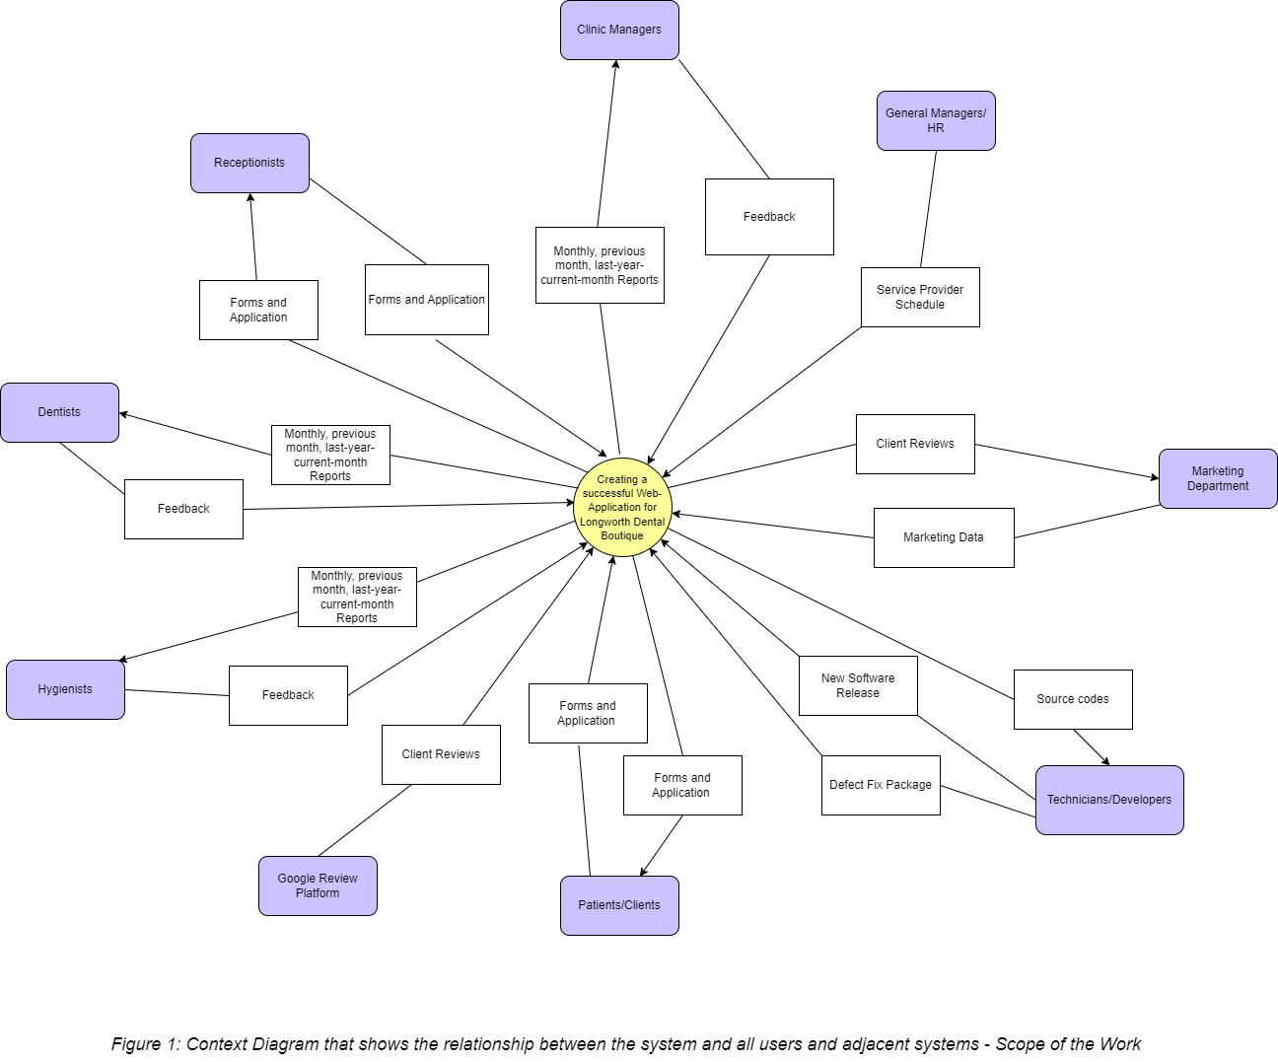
Project Scope

Slide 3
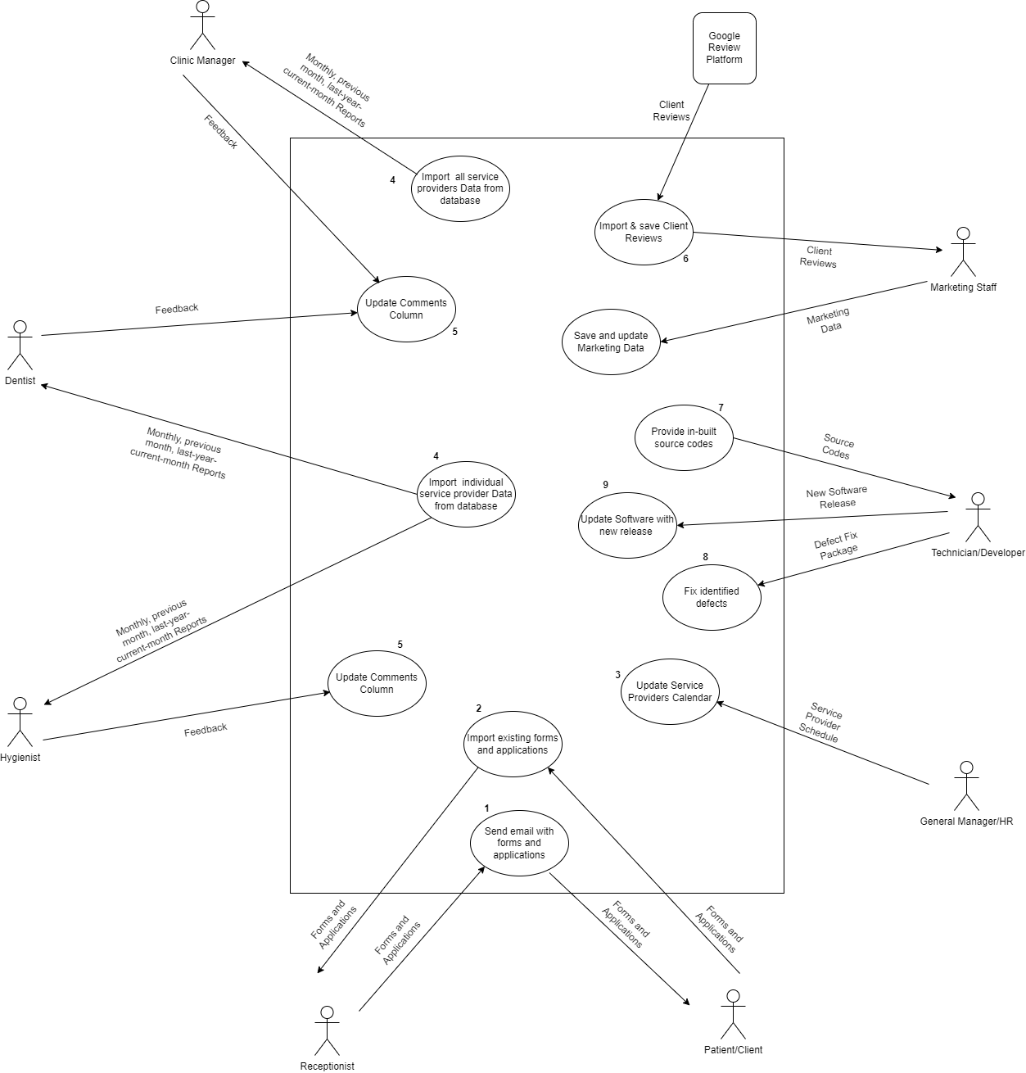
Use Case Diagram

Slide 4
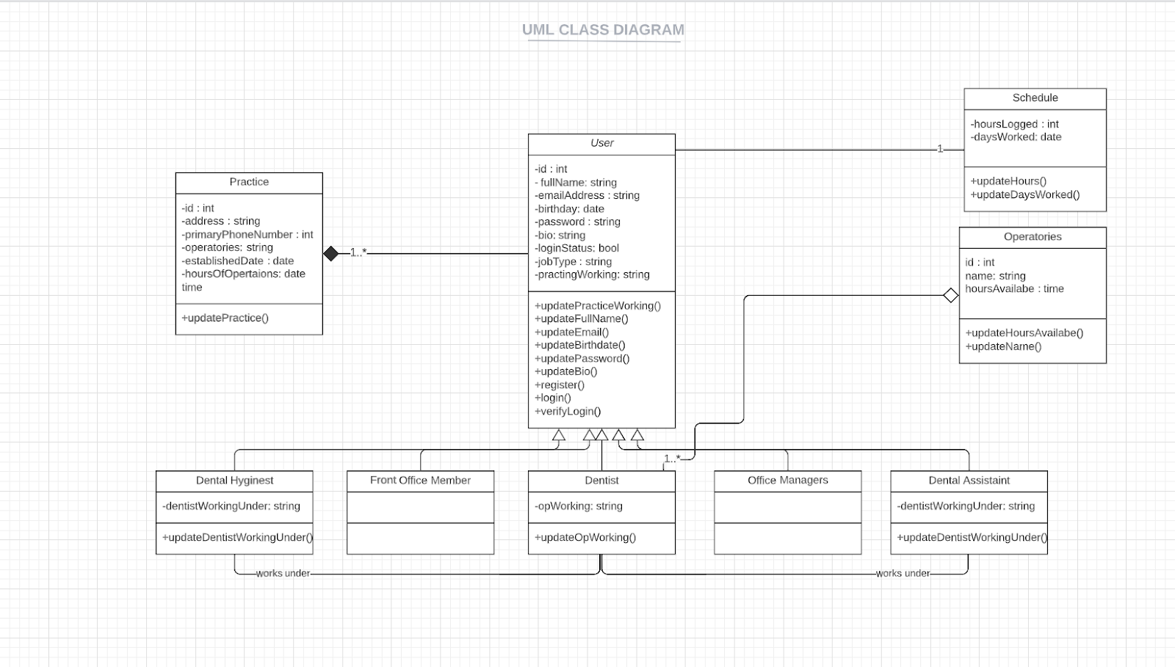
Class Diagram

Slide 5
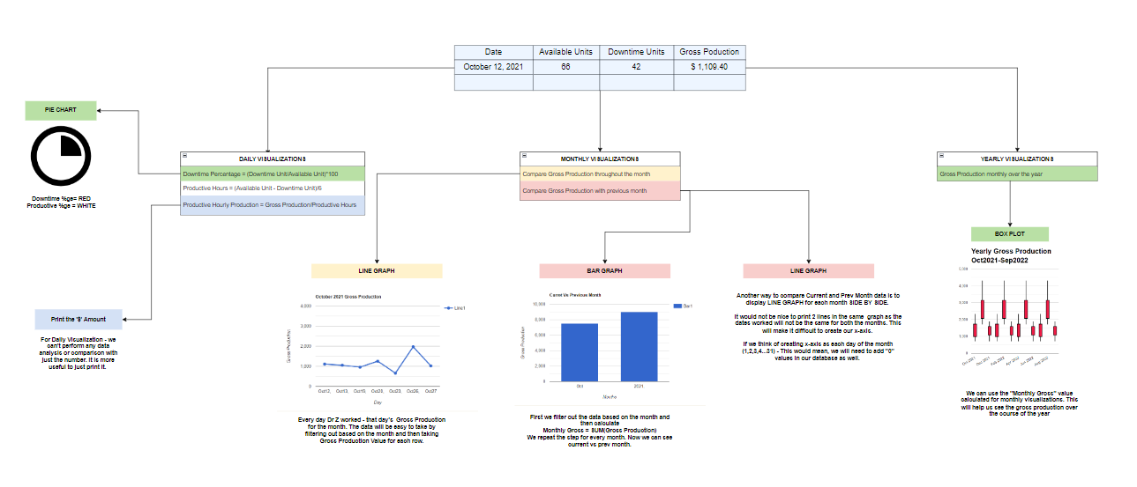
Data Analysis using Data Visualization Tools

Slide 6
LIVE DEMO

